Slide 1
PI Webcam Server
Alejandro Aguilar
Brian Faure

Slide 2
Purpose/Concept
Have a Webcam that would provide constant images of an area
Cost efficient
Easy Installation
Usages
Security
Baby Monitor
Plant Monitor

Slide 3
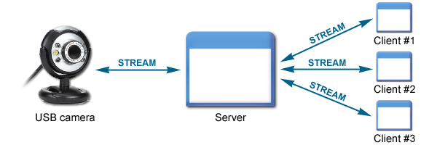
Functionality
Camera will be taking constant images
Images will be uploaded to a server
From any computer a live view can be seen of area

Slide 4
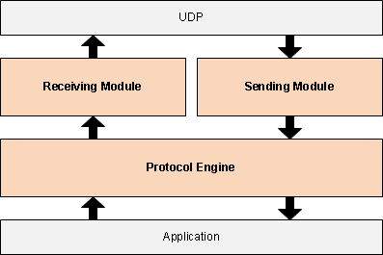
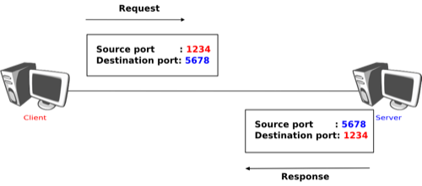
Protocol
Our design uses UDP Protocol
Simple file transfer to remote host
Unreliable but faster
Can deliver to more than one client

Slide 5
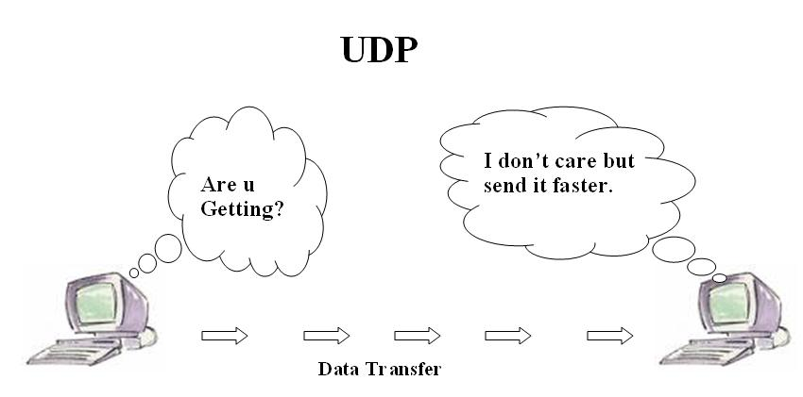
Improvements
Speed
For larger sized images speed is an issue
Make viewing on mobile possible

